Slide 1
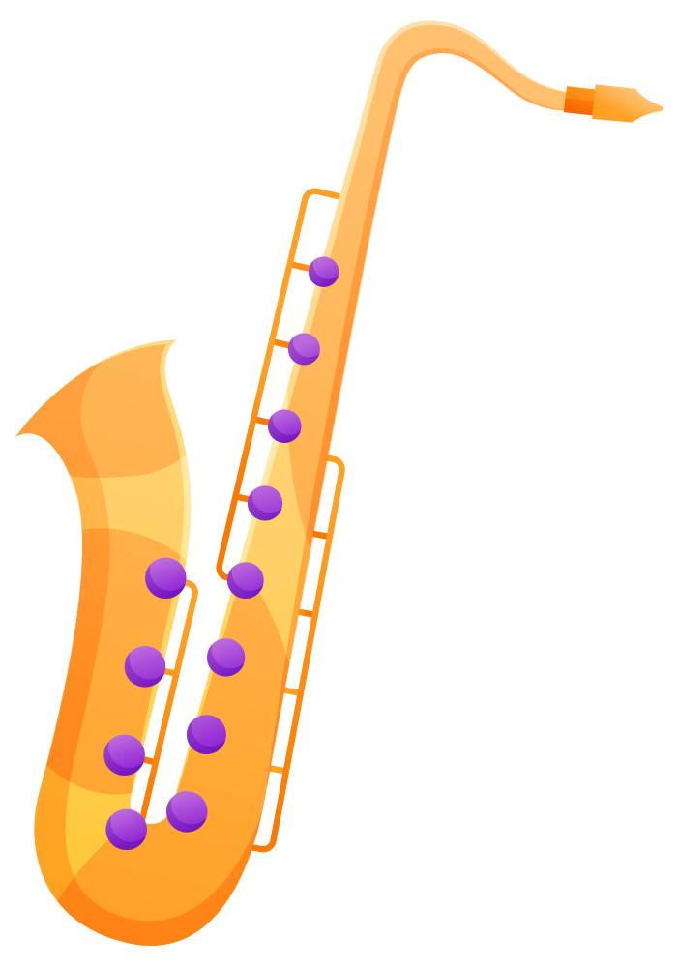
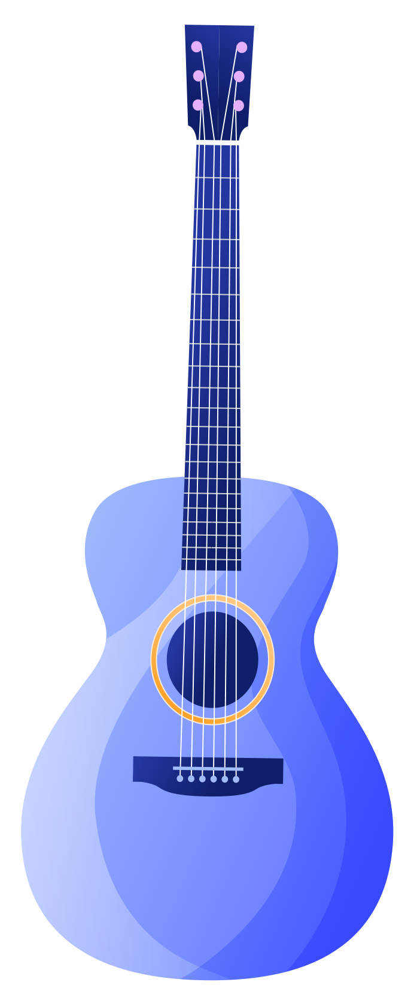
Musical Instruments Detection
By : Nouran Hassan 2022/00062
Presented to
Dr. Alaa Hamdy

Slide 2
Table of contents
01
02
03
04
Introduction
Dataset and methodology
Problem Description and Objectives of the project
Dataset and the Steps of the project
Deep learning Models
Testing Results
Model training
Testing, Evaluation and accuracy

Slide 3
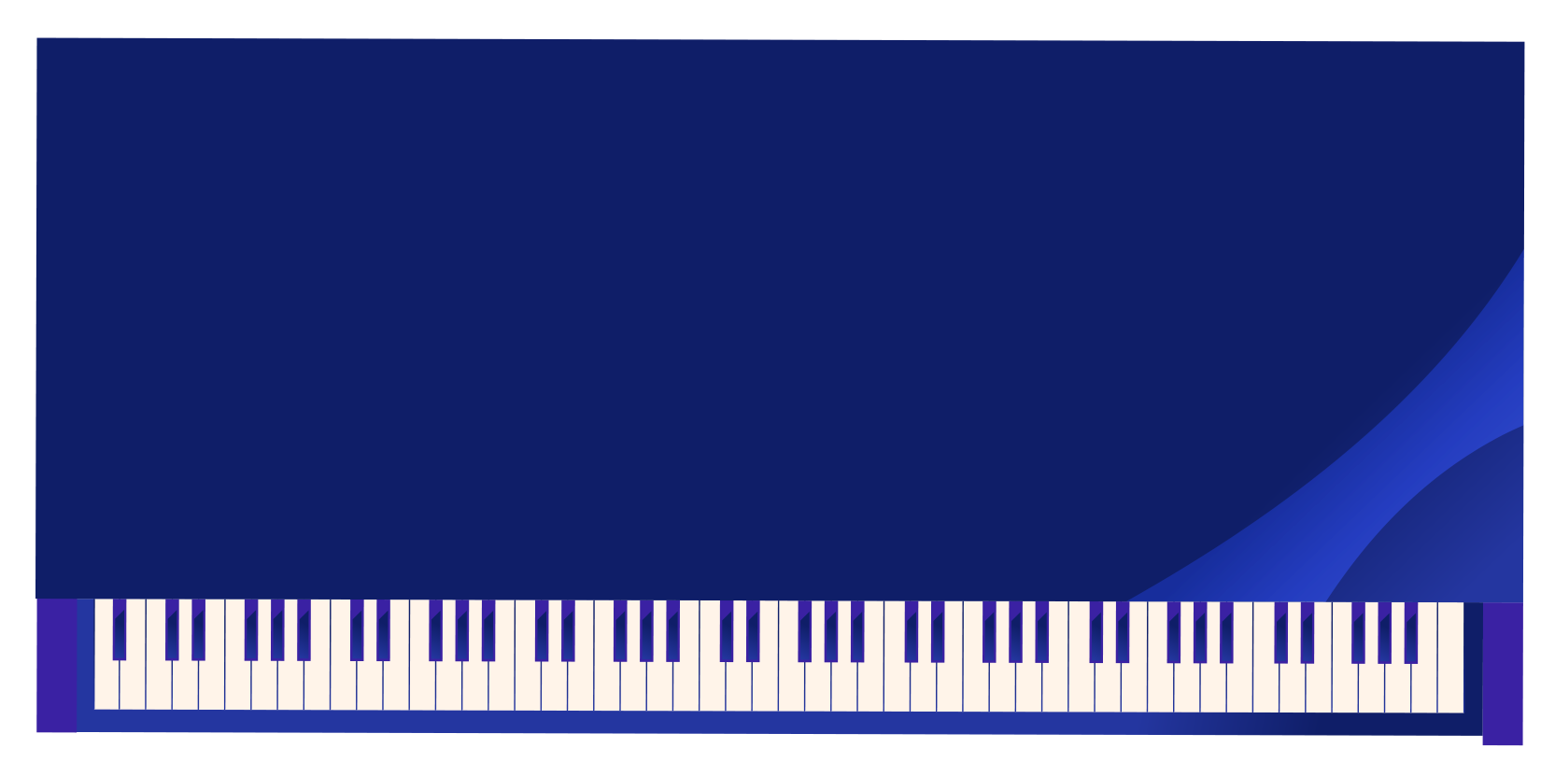
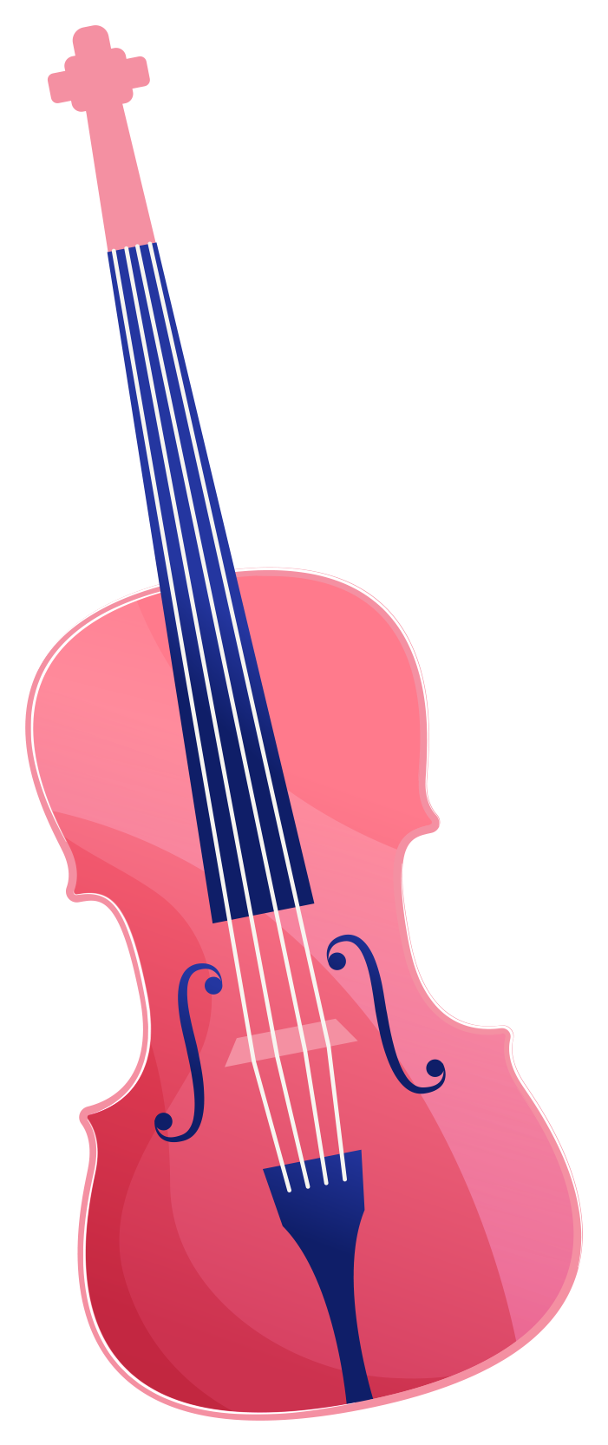
01
Introduction
Problem Description and Objectives

Slide 4
Problem Description
Classifying musical instruments from images is difficult due to visual similarities, poor image quality, and class imbalance. Accurate detection is essential for applications like music education and automated tagging, but traditional methods often lack scalability and generalization.
Objectives
To develop an efficient and accurate Music instrument recognition system using Deep learning techniques, capable of classifying instruments from images

Slide 5
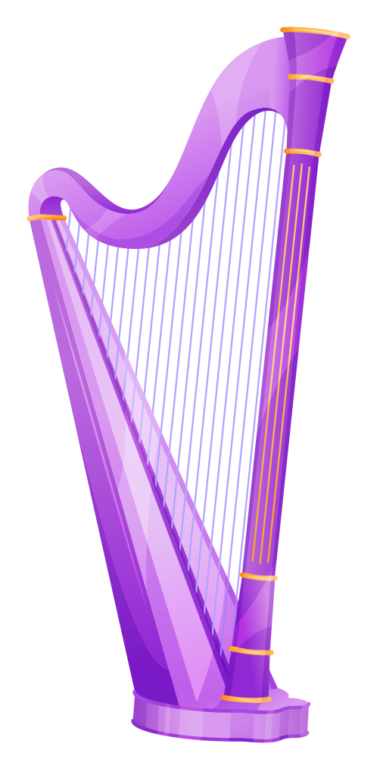

Dataset and Methodology

Slide 6
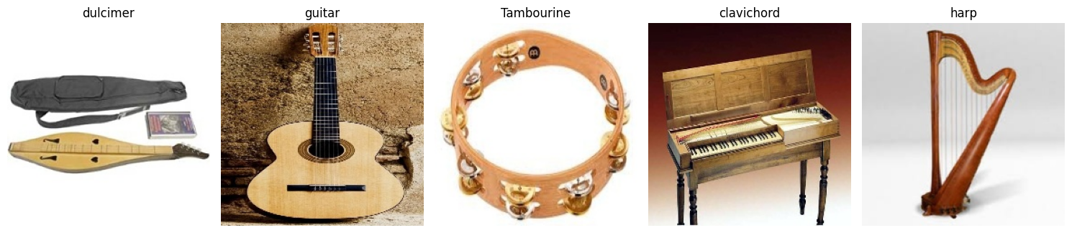
Methodology: Dataset
Source: Kaggle – Musical Instruments Image Classification
Total Classes: 30 musical instruments
Image Format: JPG
Image Size: 224 × 224 × 3
Data Split:
Training: 4,793 images
Validation: 150 images
Testing: 150 images
Note: Dataset contains some class imbalance, which was addressed

Slide 7
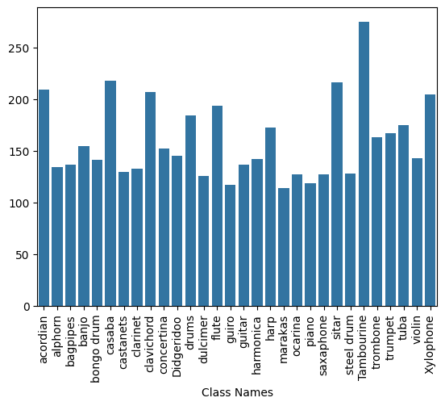
Methodology: Implementation Steps
Step 1 - Image Acquisition
Dataset divided into Training and Testing directories.
Subfolders organized by instruments class.
Step 4 - Class Imbalance Handling Method: Synthetic Data Generation & Weighted Loss. Analyzed per-class distribution showing 117 (guiro) to 275 (tambourine) samples. Implemented SMOTE oversampling for minority classes and class-weighted loss function during training. Final distribution balanced to ±5% deviation across all 30 instrument classes
Step 2 - Loading Data
Loaded images and labels from directories.
Images converted to NumPy arrays for processing.
Step 3 - Data Augmentation Method: Geometric and Photometric Transformations. Images resized to 224×224 pixels, processed in RGB color space. Applied random rotations (±20°), width/height shifts (±20%), horizontal flips, and zoom variations (±20%). Augmented samples normalized and integrated with original dataset for balanced training.

Slide 8
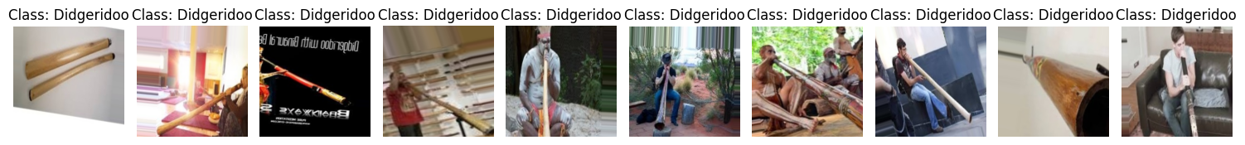

Slide 9
Deep Learning Models

Slide 10
Deep Learning Models
MobileNet
GoogleNet
Fast & efficient (98% accuracy).
High accuracy with parallel convolutions (98%).
ResNet50
VGG16
Deep network with skip connections (94.7%).
Simple but slower (89.3%).

Slide 11
Tailoring Model Heads for Optimal Performance
MobileNet GlobalAvgPool → Dense(512) → Dropout(0.5) → Dense(256) → Softmax Lightweight adaptation with aggressive dropout to prevent overfitting InceptionV3 GlobalAvgPool → Dense(1024) → Dropout(0.5) → Dense(512) → Softmax Larger dense layers to handle complex feature combinations ResNet50 GlobalAvgPool → Dense(512) → BatchNorm → Dropout(0.5) → Softmax Added BatchNorm for stability in deeper networks VGG16 GlobalAvgPool → Dense(1024) → Dropout(0.5) → Dense(512) → Softmax Heavier fully-connected layers compensate for rigid convolution blocks

Slide 12
Accuracies
Model | Accuracy | Training Time | Best For
MobileNet | 98% | 120 mins | Mobile/Edge devices
InceptionV3 | 98% | 180 mins | High-precision tasks
ResNet50 | 94.7% | 150 mins | Detailed textures
VGG16 | 89.3% | 210 mins | Academic baseline

Slide 13
Testing Results

Slide 14
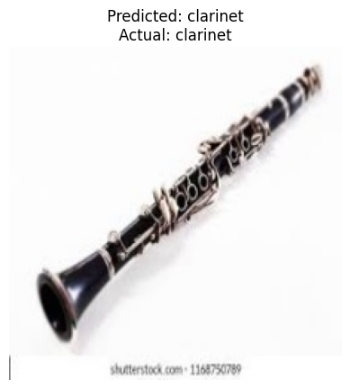
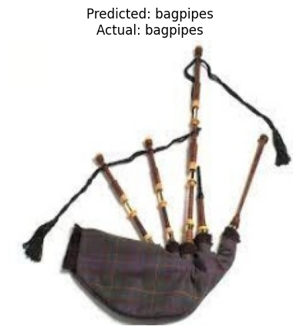
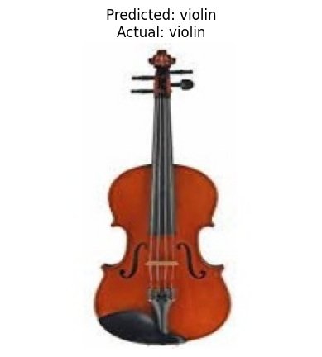
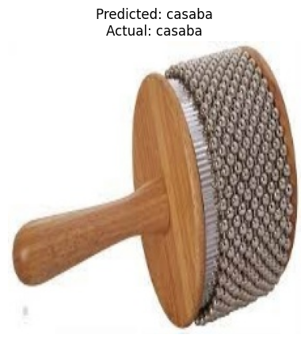
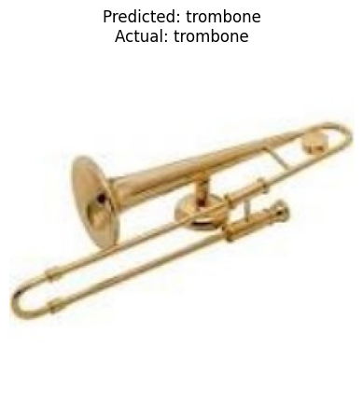
Test Results
Testing Process Diagram: 📁 Test Set → 🎲 Random Selection → 🧠 Model → 📊 Prediction

Slide 15
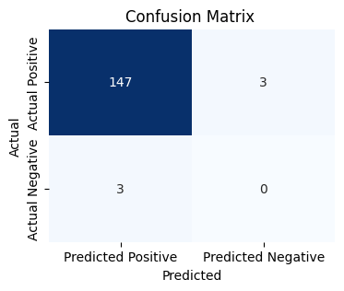
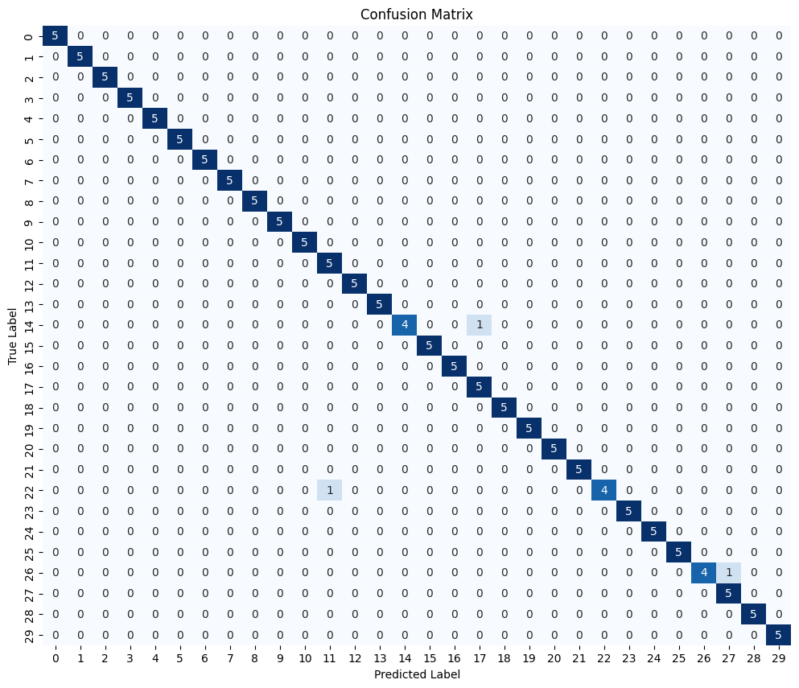
Test Results

Slide 16
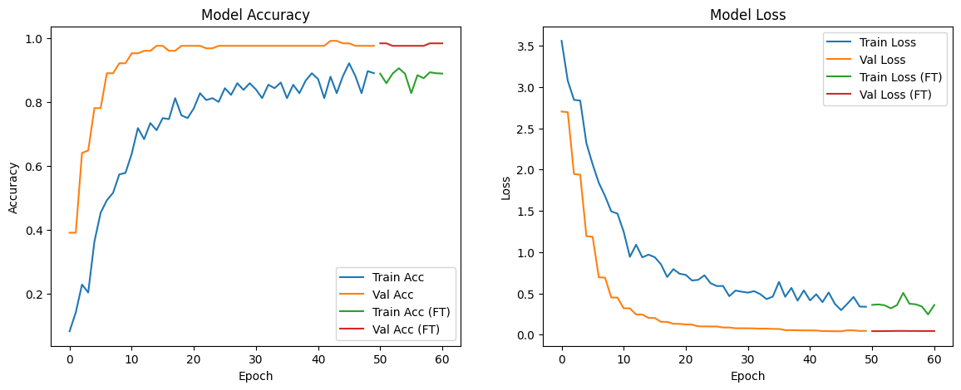
Test Results

Slide 17
Thank You!

